Slide 1
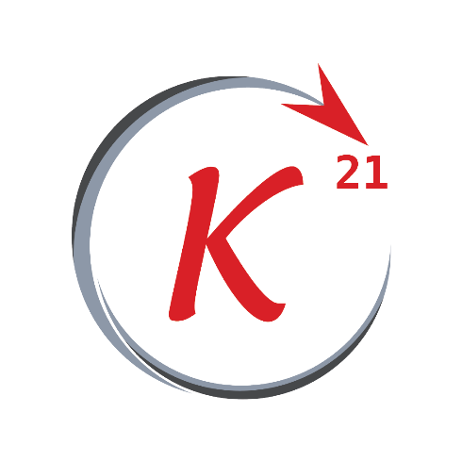
Multivariate Linear Regression

Slide 2
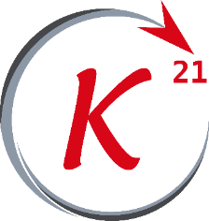
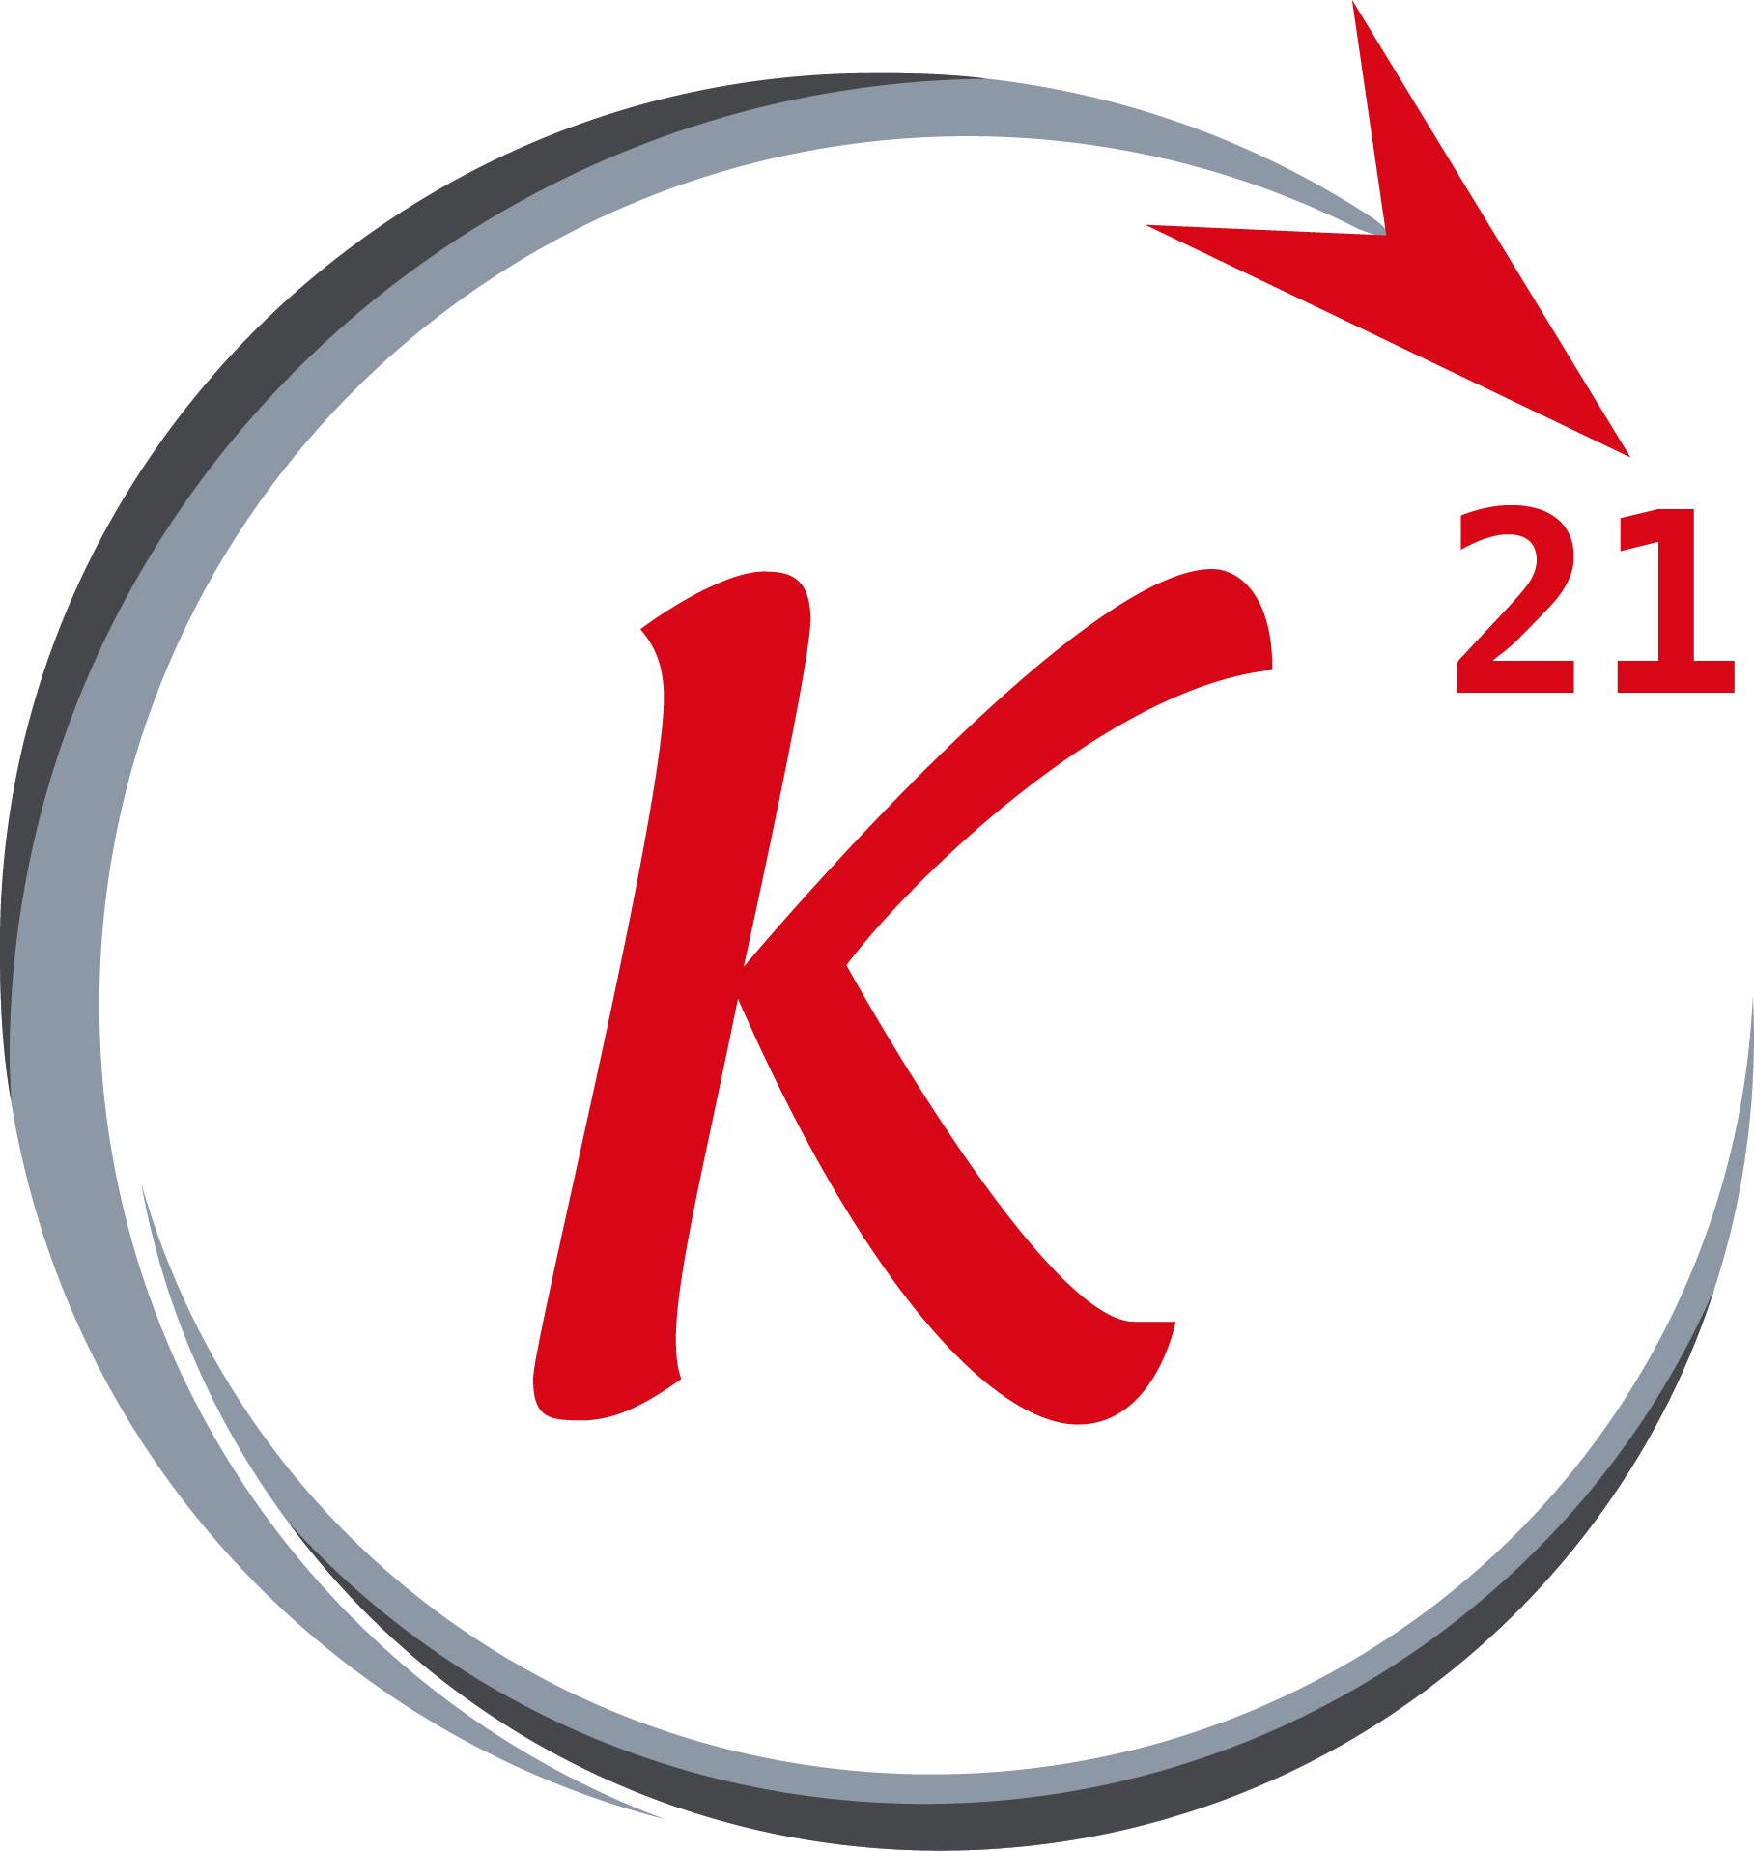


Multiple linear regression
Outline
- Multiple features
- Cost function
- Gradient decent
- Bias
- Features scaling
- Types of features scaling
- Feature selection
- Normal equation
Grow Through

Slide 3
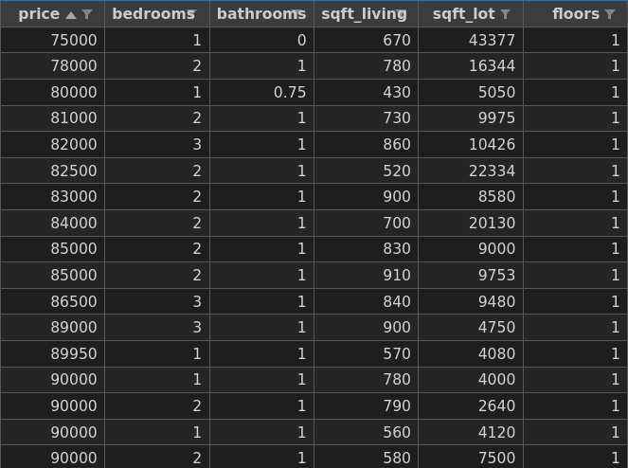
Multiple features
Variables
The data shown in the
figure has 5 features
each of which is a
variable used to find
the best fit line.
Grow Through

Slide 4
Multiple linear regression
Notation
Each row is denoted with the superscript (i) in x^{(i)}. e.g. x⁽³⁾ refers to the 3rd row in the data set
Grow Through

Slide 5
Multiple linear regression
Notation
Each feature is denoted with the subscript (i) in x^{(i)}. e.g. x⁽⁴⁾ refers to the 4th feature in the data set.
Grow Through

Slide 6
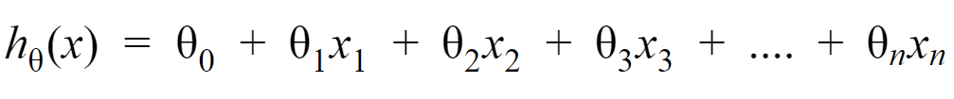
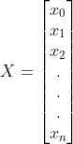
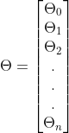
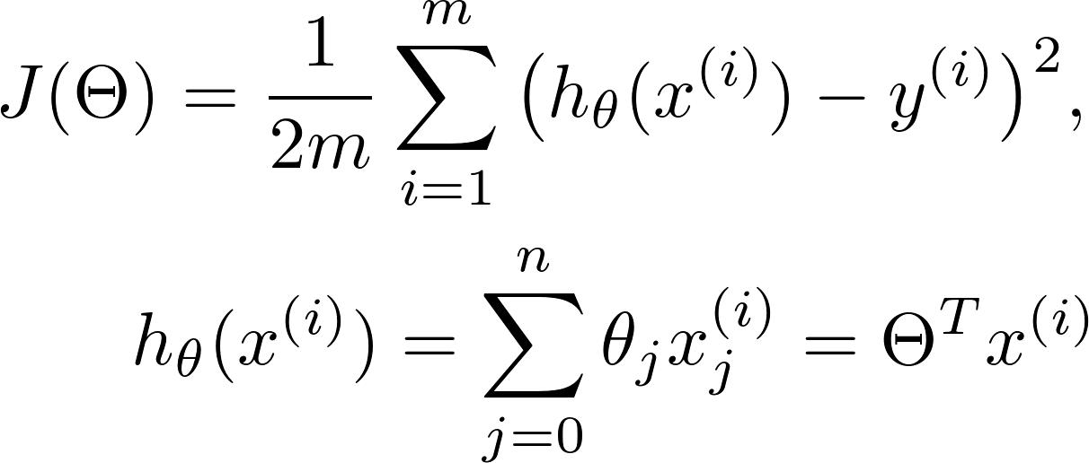
Multiple linear regression
Hypothesis function
The updated hypothesis when dealing with n different features.
Also another form of the equation is :
Where:
And x₀ = 1
Grow Through

Slide 7
Cost function
J
For a data set that has n different features and m training examples,
The cost function for it is:
Grow Through

Slide 8
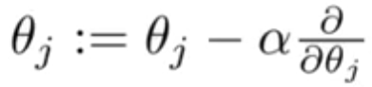
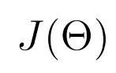
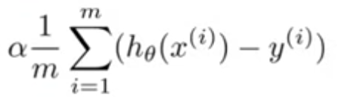
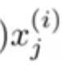
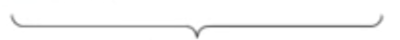
Gradient descent
Calculating theta
The equation for gradient descent is the same as before but with j being an integer in range(0,n).
Grow Through

Slide 9
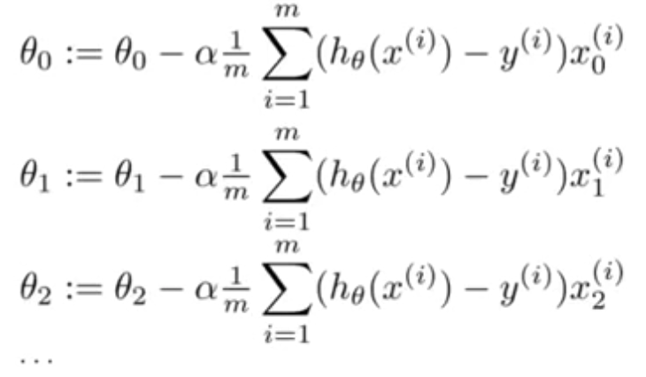
Gradient descent
Calculating theta
and so on
Grow Through

Slide 10
Bias
Bias basically means that the gradient descent tends to change the theta_{j} that corresponds to a high value X_{j} because it affects the cost function more than other parameters, causing the gradient descent to converge slowly or not being able to converge at all in most cases.
Grow Through

Slide 11
Bias
As an example, if a training set has a feature that ranges between (100 - 5000) -maybe a car’s height in centimeters- and another that ranges between (0.1 – 2) -like a car’s engine’s volume in kilo cubic centimeters-, the gradient descent will try to tweak the 1st feature first although a car’s price might be less dependent on it than the other feature, this might cause the gradient descent to take much longer time & path getting to the minimal J and in some cases might cause the path of the gradient descent to drift away from the conversion point causing it to break.
Grow Through

Slide 12
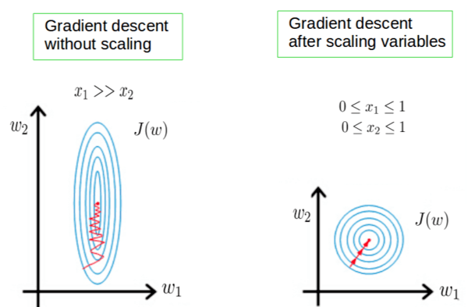
Feature scaling
Here is a graph that represents the previous example.
Grow Through

Slide 13
Types of feature scaling
Types
3 types that we will discuss and use them apply feature scaling:
- Mean Normalization
- Standardization (Z Normalization)
- Unit Vector Normalization
Grow Through

Slide 14
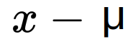
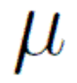
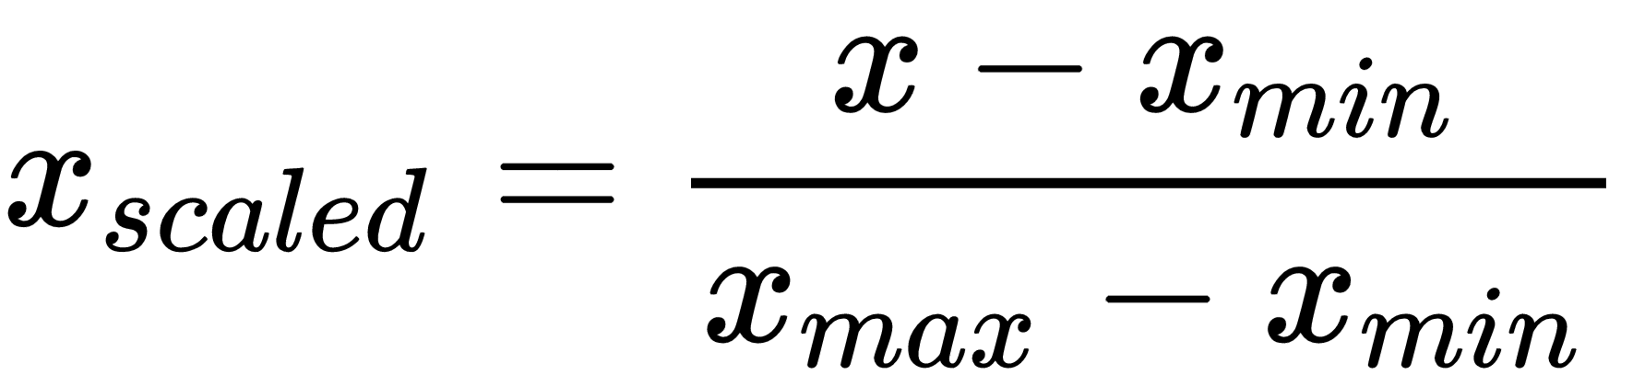
Types of feature scaling
Mean Normalization
Produces scaled features that is between (-0.5) and (0.5).
Grow Through

Slide 15
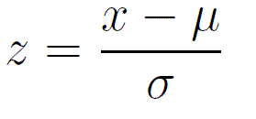
Types of feature scaling
Standardization
Standardization on a feature causes it to have mean of zero and a unit of variance.
Grow Through

Slide 16
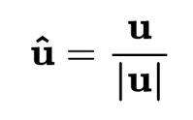
Types of feature scaling
Unit Vector Normalization
Scaling to unit length shrinks/stretches a vector (a row of data can be viewed as a D-dimensional vector) to a unit sphere.
*applies to a row of data set
Grow Through

Slide 17
Feature selection
Feature selection is a process where we choose the features which contributes the most in the output value and ignoring features that are irrelevant or with a tiny contribution, as having too many features that are irrelevant in our data set decreases the accuracy of the trained model.
Grow Through

Slide 18
Normal equation
Formula
Grow Through

Slide 19
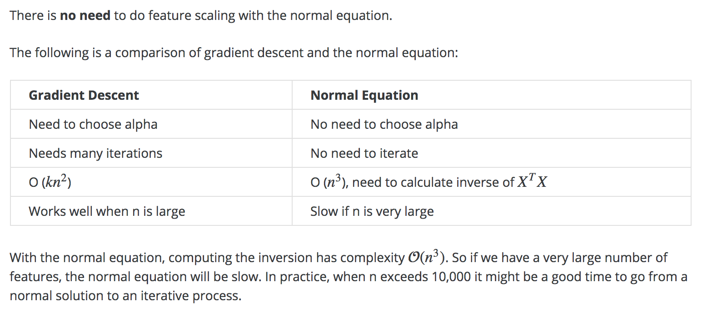
Normal equation
vs GD
Grow Through

